Slide 1
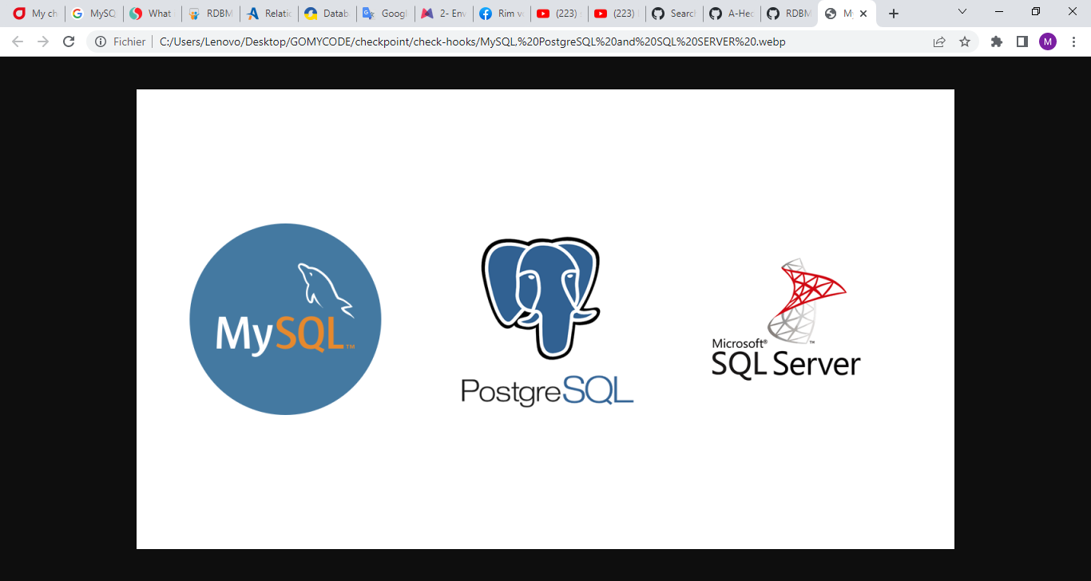
RDBMS Checkpoint DataBases introduction: presentation of few RDBMS

Slide 2
What is RDBMS ?
Relational Database Management System is a a type of data store organizing data into tables that are related to one another wich explains the name . Structured Query Language is the core of these systems as it is used to communicate with and manage these databeses, having given birth to their second name — SQL databases. RDBMSs have a predefined schema, meaning data resides in rows (record) and columns(attributes) with a strict structure. Here, each record usually holds a value for each attribute, resulting in clear dependencies between different data point.
A few example of RDBMS : MySQL, PostgreSQL and SQL SERVER.

Slide 3
MySQL
This is one of the most popular relational database systems. Originally an open-source solution, MySQL now is owned by Oracle Corporation. Today, MySQL is a pillar of LAMP application software.
Pros of MySQL :
Free installation
Sipmle suntax and mild complexity
Cloud comptabilit
Cons of MySQL :
Scalability challenges
Partial open-source support
Limited compliance with SQL standards

Slide 4
PostgreSQL :
This database management system shares its popularity with MySQL. This is an object-relational DBMS where user-defined objects and table approaches are combined to build more complex data structures.
Pros of MySQL :
Great scalability
Support for custom data types
Open-source and community-driven support
Easily-integrated third-party tools
Cons of MySQL :
Inconsistent documentation
Lack of reporting and auditing instruments
Limited compliance with SQL standards

Slide 5
SQL SERVER :
Is a relational database managmenet system, developed and marketed by Microsoft.
It was buildet to manage and store information. The system support various business intelligence operation, analytics operations, transaction processing.
Pros of SQL SERVER :
Easy to install, Enhanced performance
Highly secure
Excellent Data Restoration and Recovery Mechanism
Lower Cost of ownership
Cons of SQL SERVER :
Complex Interface
Cost
Partial control

Slide 6
 | MySQL | postgresSQL | SQL SERVER
Database type | SQL | Object-relational SQL | T-SQL
Licensing | GNU Generally Public Licence | Open source | Proprietary
Scalability | Vertical complex | vertical | Vertical complex
Data types supported | Structured, semi-structured | Structured, semi-structured, unstructured | Structured, semi-structured, unstructured
Learning curve | Mild | hard | Hard

